Slide 1
Introduction to Dataset:
Differential gene expression with FTO depletion
(ENCODE experiment ENCSR688GVV)

Slide 2
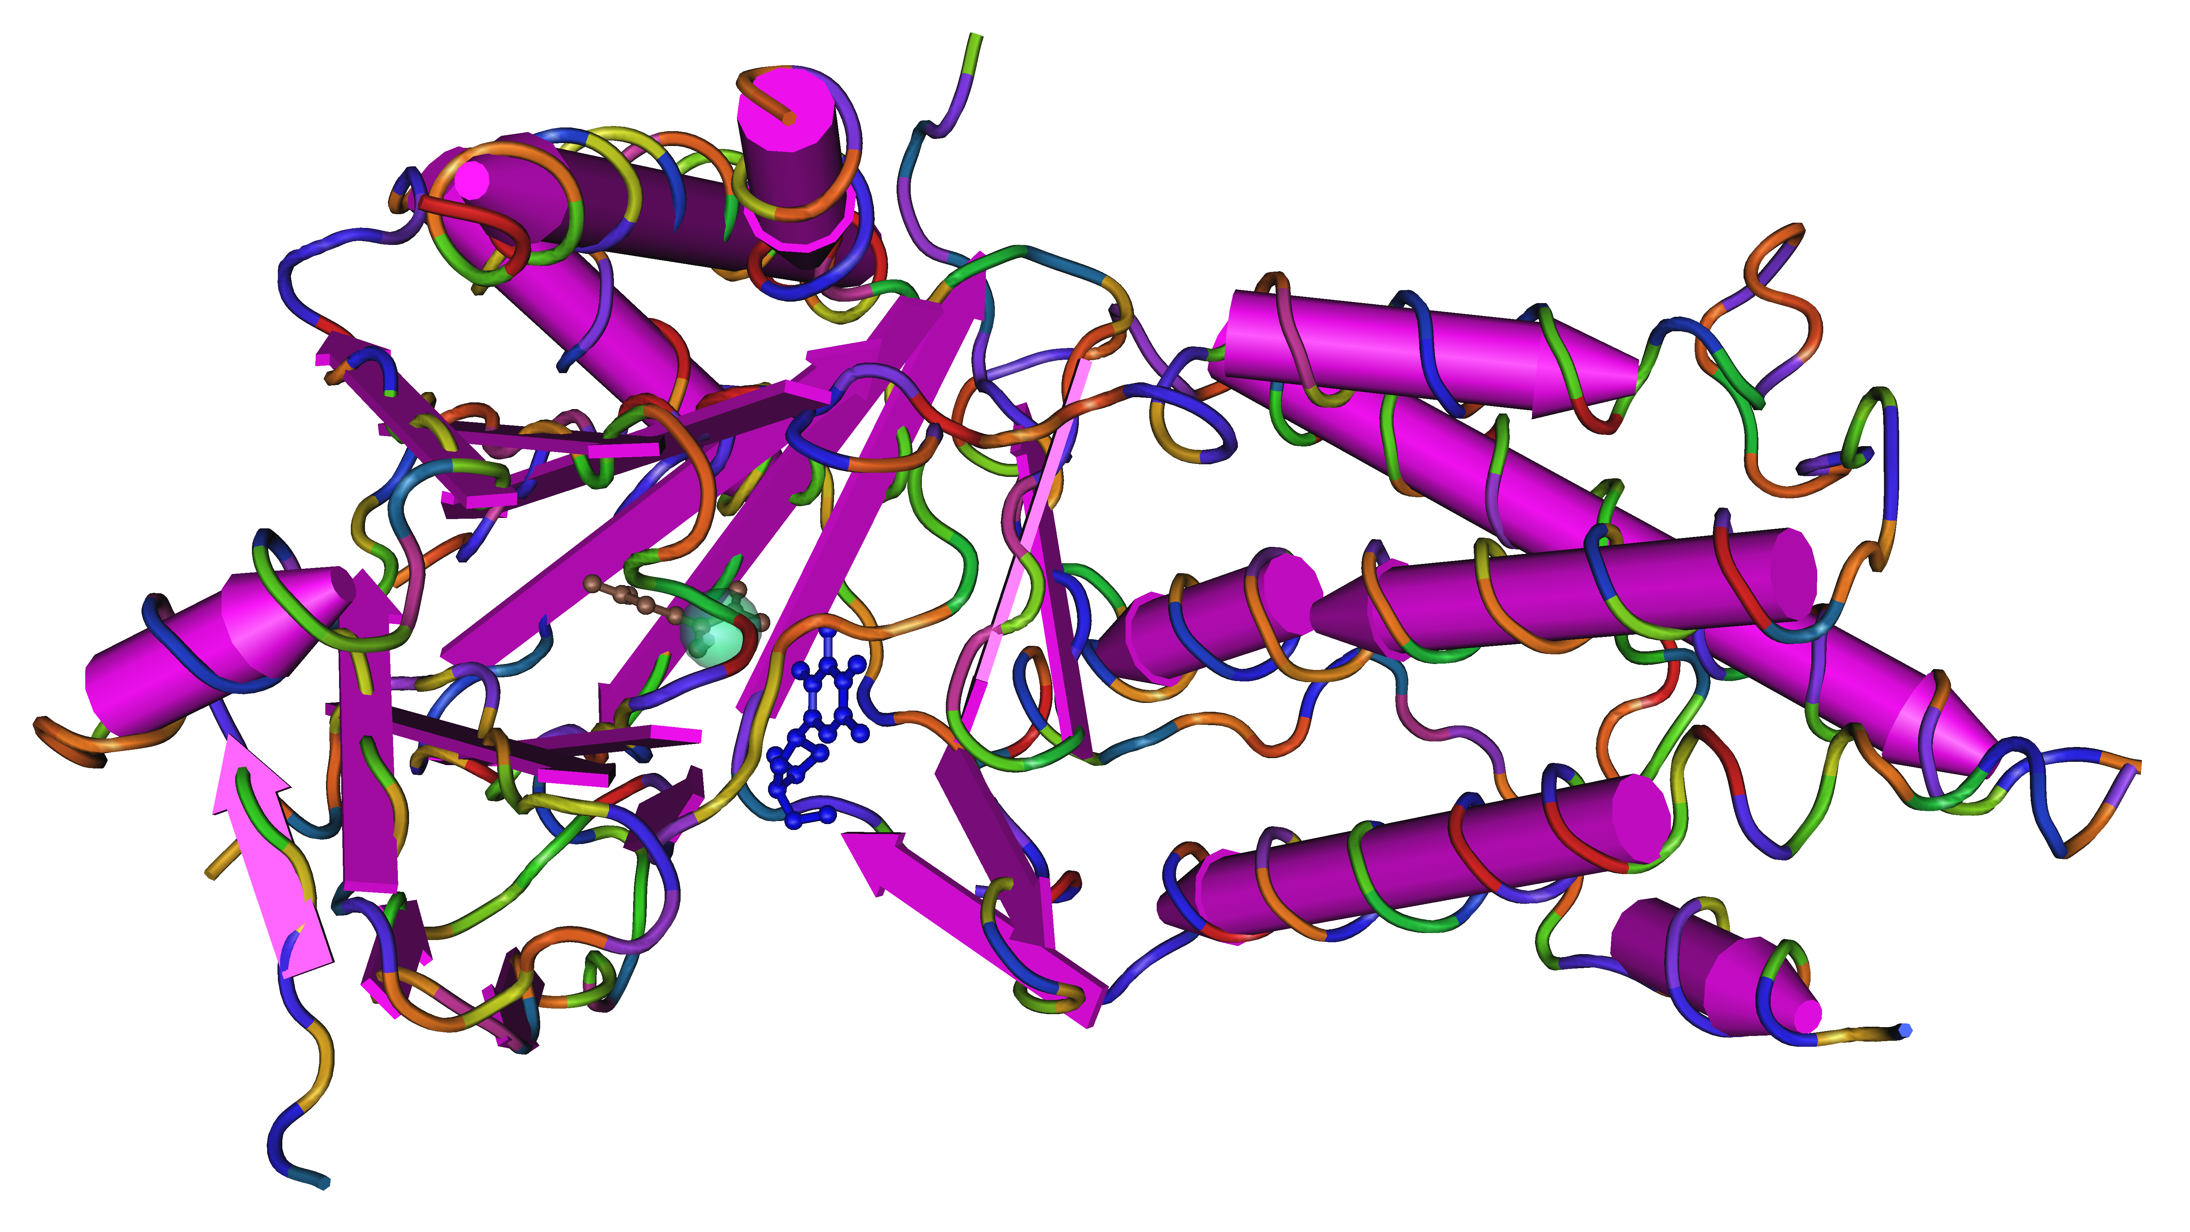
FTO (Fat mass and obesity-associated protein)
Homolog of AlkB proteins (2-oxoG-dependent DNA demethylase)
Widely expressed in all tissues of the body from fetal to adult stage
Genetically associated with polygenic obesity in humans and mice
AlkB DNA Damage Repair Mechanism
Notes:
AlkB related non-haem iron and 2-oxoglutarate-dependent oxygenase
- remove alkylation damage from the positively charged 1-methyl adenines and 3-methyl cytosines, but also from the neutral bases of 1-methyl guanine and 3-methyl thymine (remove DNA lesions that DNA polymerase would not be able to traverse) caused by alkylating agents such as EMS

Slide 3
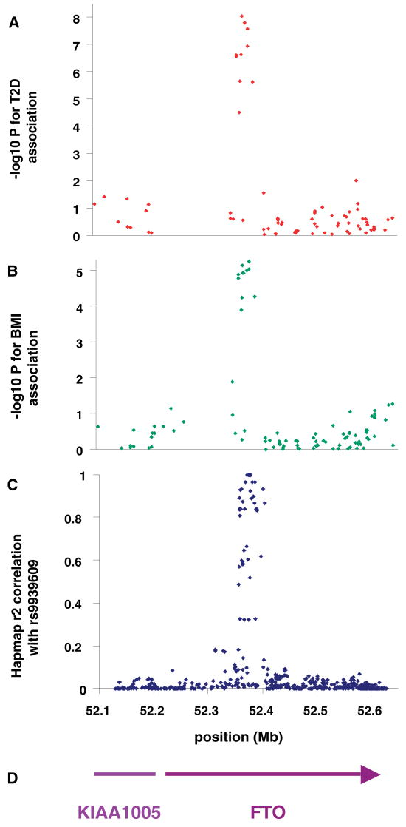
FTO as a disease risk allele
Large European cohort (n=38,759) identified FTO as risk allele for obesity (indirectly diabetes)
Risk variants at rs9939609 associated with increased food intake and decreased satiety
FTO risk alleles associated with lower fat cell lipolysis
Variant is in non-coding region that interacts with promoter of FTO and homeobox gene IRX3
May also be associated with frontal lobe volume in brain and increased risk of Alzheimer’s disease
Frayling et al., Science 2007

Slide 4
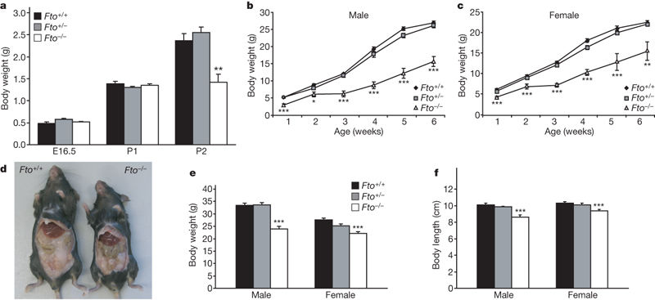
FTO KO mice show decrease in body mass
Mice with FTO knockout have reduced body mass compared to WT mice
Reduction in body weight found to be associated with increased energy expenditure
Protection from obesity directly links FTO to energy homeostasis
FTO overexpression model leads to increased body and fat mass (Church et al, Nature Genetics 2010)
Fischer et al., Nature 2009

Slide 5
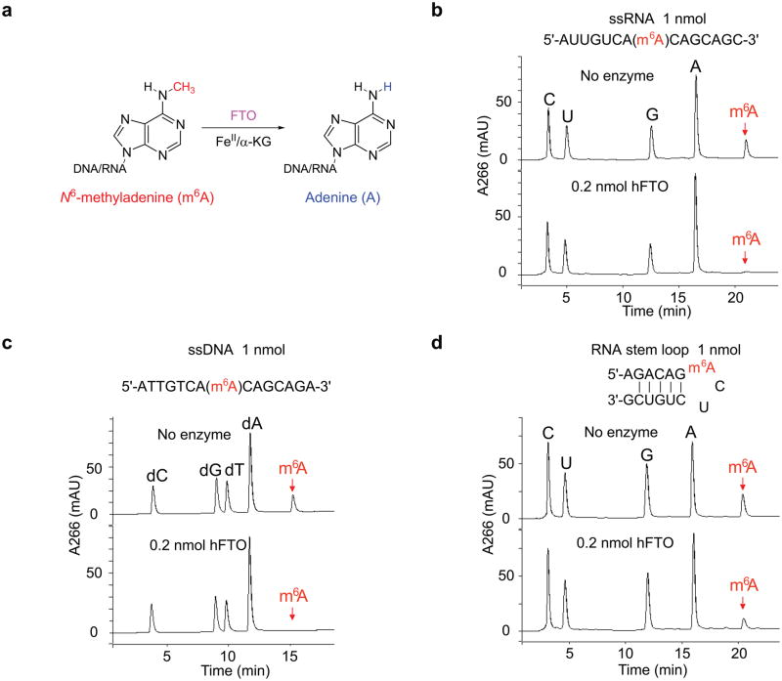
FTO and its role in epitranscriptomics
Previously shown to oxidatively N-methylated DNA/RNA bases, though substrates unknown
FTO had been shown to demethylate N6-Methyladenosine (m⁶A) modified RNA in vitro
FTO found to regulate m⁶A content in mRNA in live cells
Jia et al., Nat Chem Biol. 2011

Slide 6
N6-Methyladenosine (m⁶A)
Prevalent RNA modification (~3–5 m⁶A per mRNA molecule in mammalian cells)
Enriched within 5’UTR and near stop codons of mRNA transcripts
Modification catalyzed by protein METTL3
Dynamically regulates gene expression post-transcriptionally

Slide 7
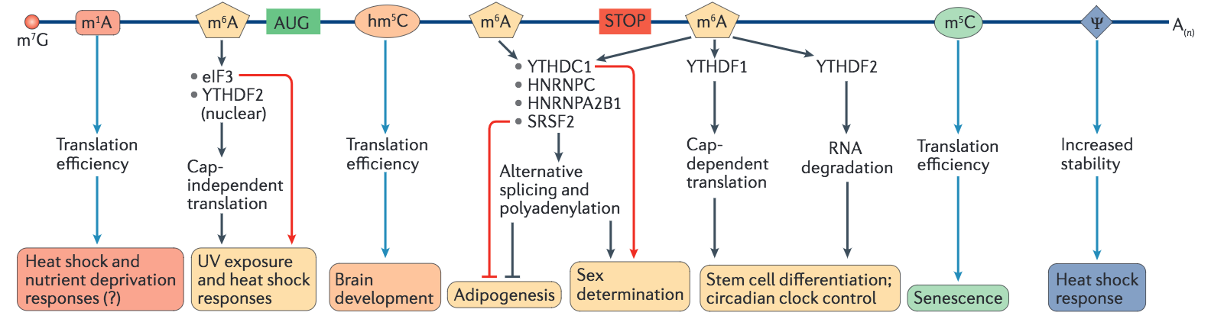
Epitranscriptomics: Broad and Impactful
mRNA
“Readers”
Processes
And Pathways

Slide 8
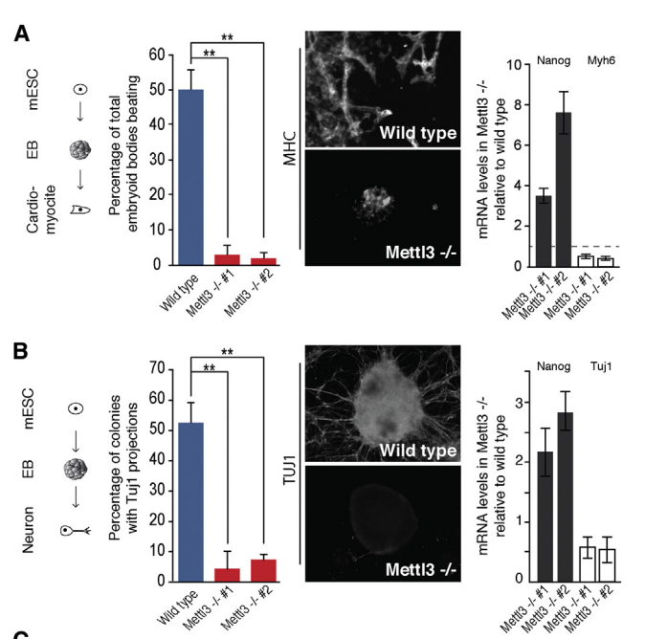
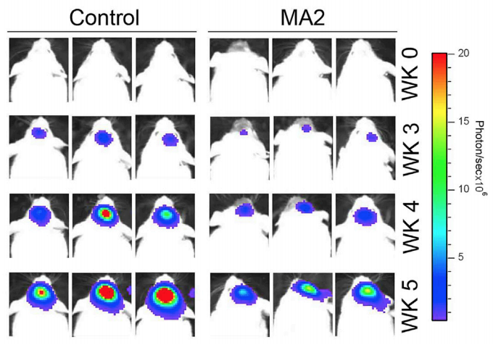
Dynamic RNA m⁶A levels regulate several biological processes
RNA processing and translation
Stem cell differentiation
Glioblastoma tumorigenesis
Frye and Blanco, Development 2016
Batista et al. Cell Stem Cell 2014
Cui et al. Cell Reports 2017

Slide 9
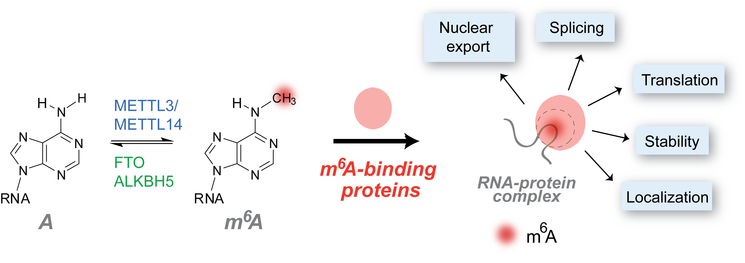
m6A and potential role on RNA metabolism
How does FTO depletion regulate global gene expression?
University of Chicago

